Slide 1
Visual Studio Team Services Extensions
Taavi Kõosaar
VS ALM MVP
Email: tkoosaar@windowslive.com
@melborp | github.com/melborp

Slide 2
Agenda
Short intro to VSTS
Visual Studio Team Services Extensions
How to get started

Slide 3

Visual Studio Team Services
Code
Insights
Agile
Deploy
Build
Test

Slide 4
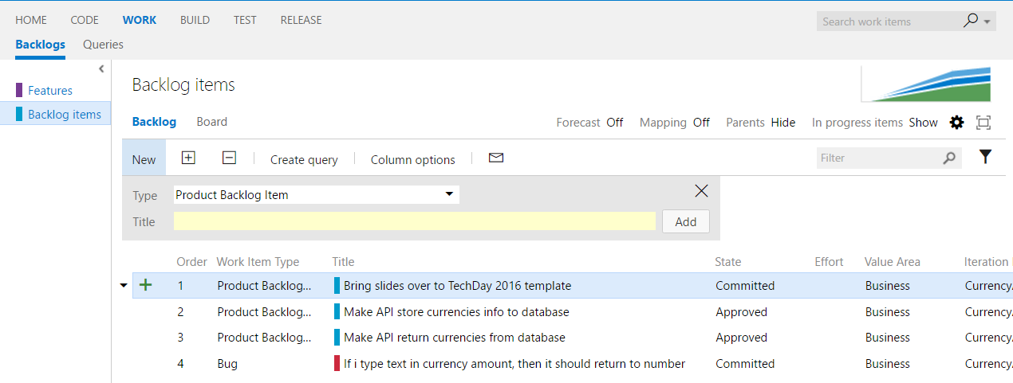
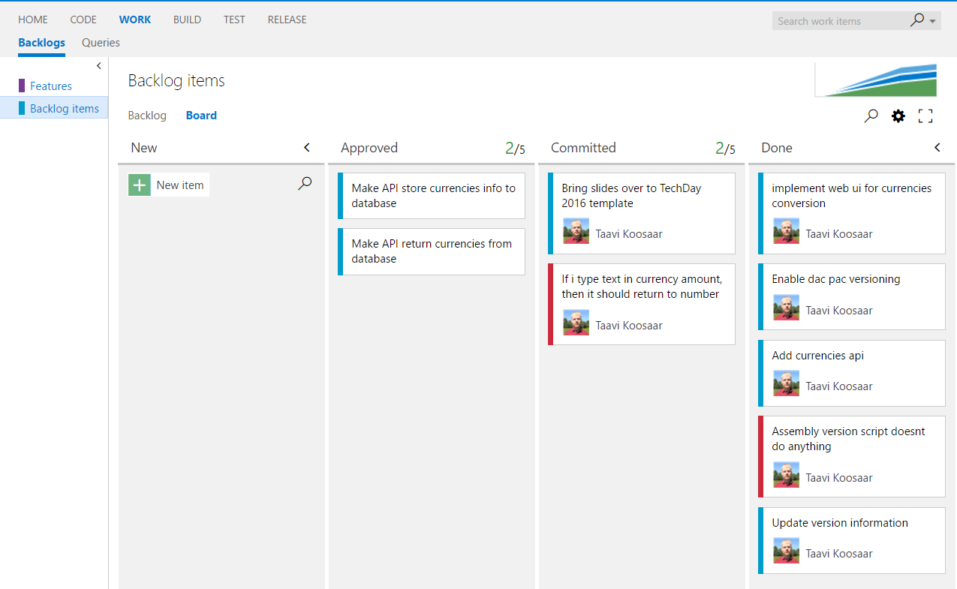
Work
Kanban and Scrum Board (Agile Portfolio Management)
Track work, organize and prioritize backlog
Create (common) queries and visualize with graphs
Wiki with Markdown support
Team Room to have discussions with history and connections to project

Slide 5
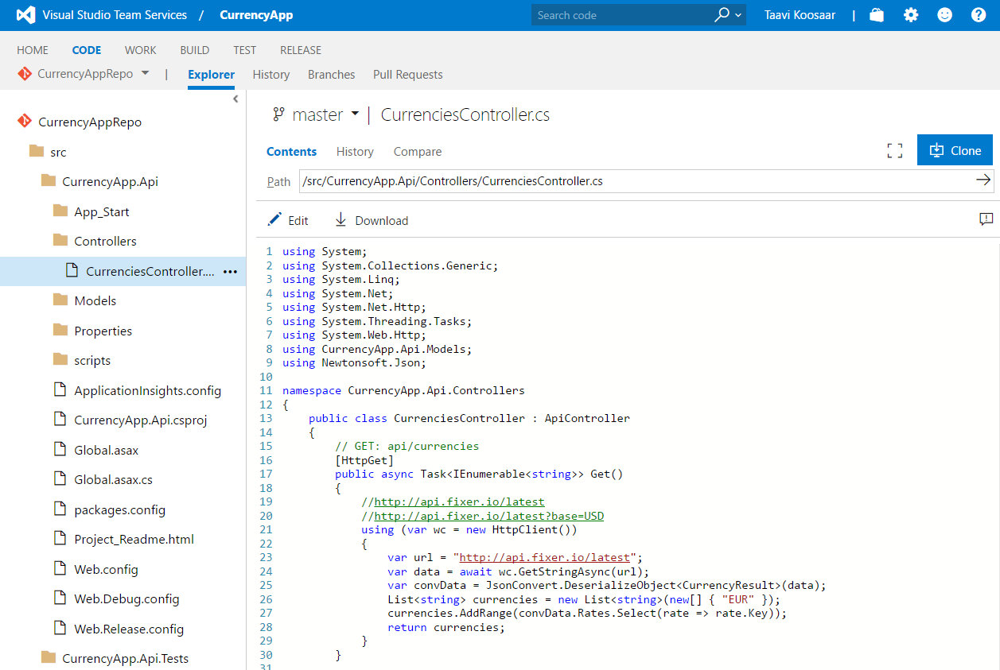
Code
Choose as code repository - Git or TFVC
Basic code editing online
Visual Studio Integration
Eclipse Integration (Team Explorer Everywhere)

Slide 6
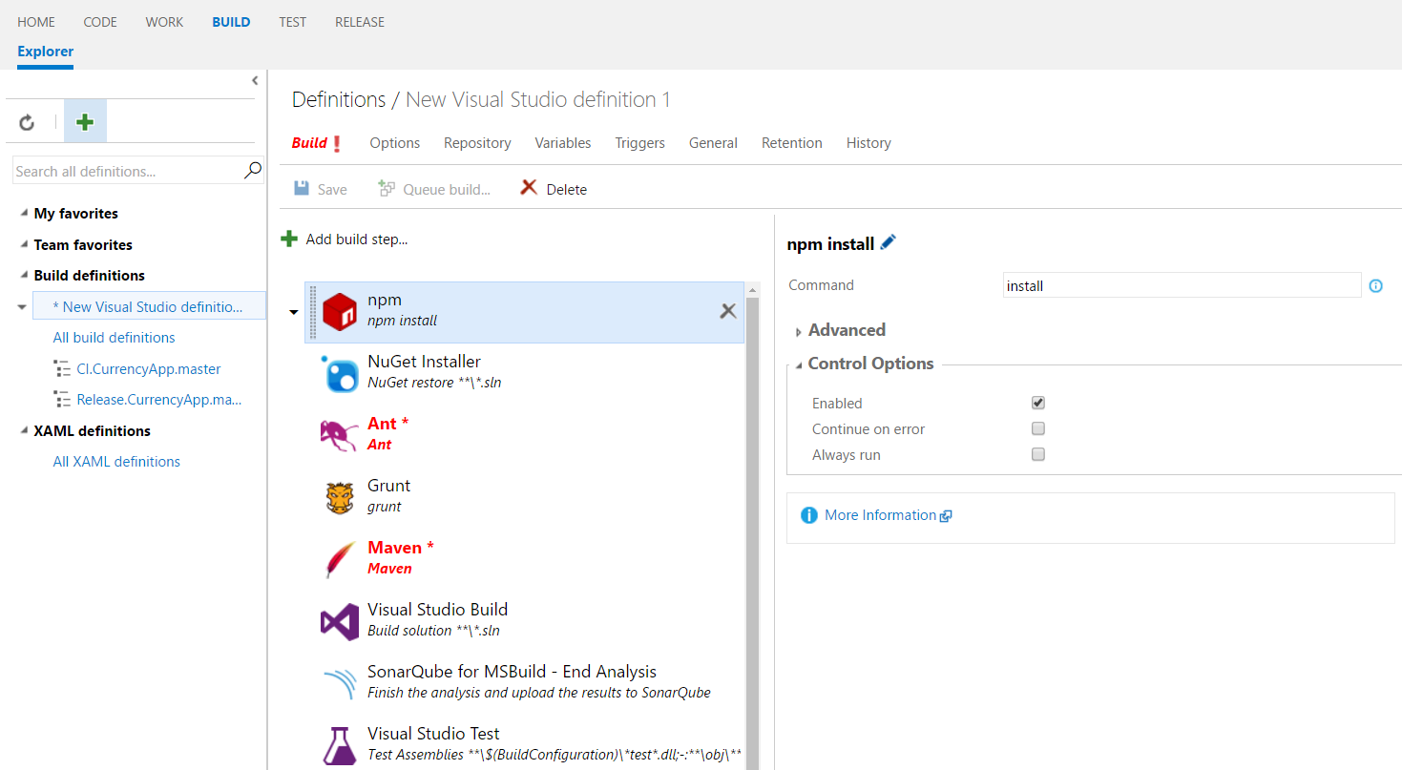
Build
Simple and extensible build engine based on tasks
Web UI to manage
Windows (powershell) and Cross-platform (nodejs) build agents
Can do anything that is available on agent (demand and capability matching)
Continuous Integration

Slide 7
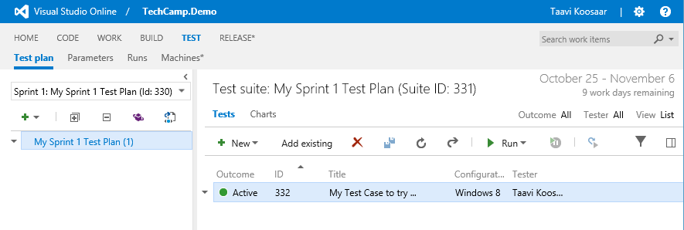
Test
Test Case Management through Test Plans, Test Suites and Test Cases
Manual Test Execution
Elastic Load Testing

Slide 8
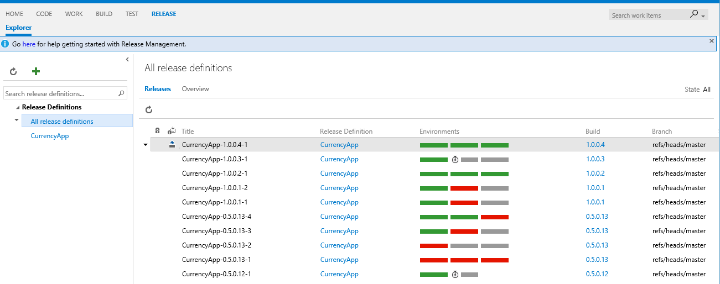
Deploy/Release
Release pipelines
Artifacts
Configuration management
Extensible tasks library
Approval flows

Slide 9
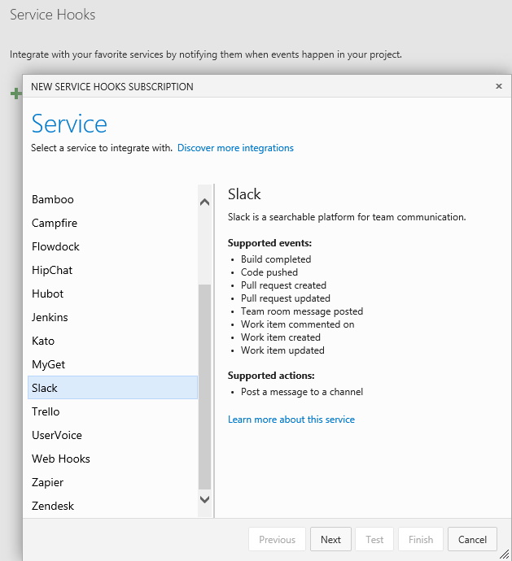
More …
Integrations and Extensibility
Service Hooks (uservoice, slack, …)
Service Endpoints (Github, Jenkins, …)
Create integrated experiences by extending VSTS
Insights
Feedback

Slide 10
Demo: VSTS

Slide 11
Visual Studio Team Services Extensions
Are a powerful way to create integrated experiences and add capabilities to VSTS using standard platform APIs (UI Controls, JS library, REST apis, …)
Are packaged as vsix and built on JavaScript, CSS, HTML

Slide 12

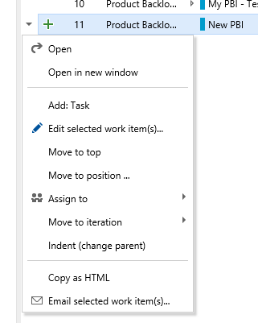
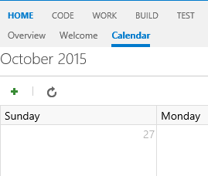
What can you extend?
Work Item Forms, hubs, menus
Add new build and release tasks
Integration to external service (e.g. Slack)
Add dashboard widgets
Full list of extensibility points (json)

Slide 13
What you need?
An idea!
Knowledge and a tool to write JavaScript, CSS, HTML
Knowledge of requirejs, promises
The API heavily relies on it
TFX-CLI to package (and publish)
(Optional: Can write TypeScript)

Slide 14
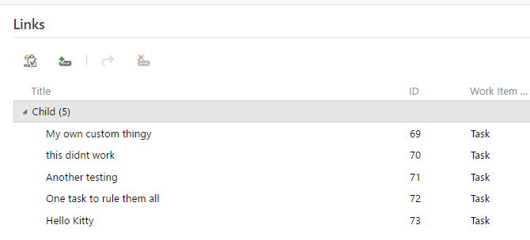
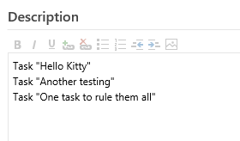
The extension we will build
As a team member, i would to auto-generate Tasks based on description details
Customize work item form
Add a new view to show result
Add tasks based on description, that are not there yet!

Slide 15
Demo: Build a cool VSTS Extensions

Slide 16
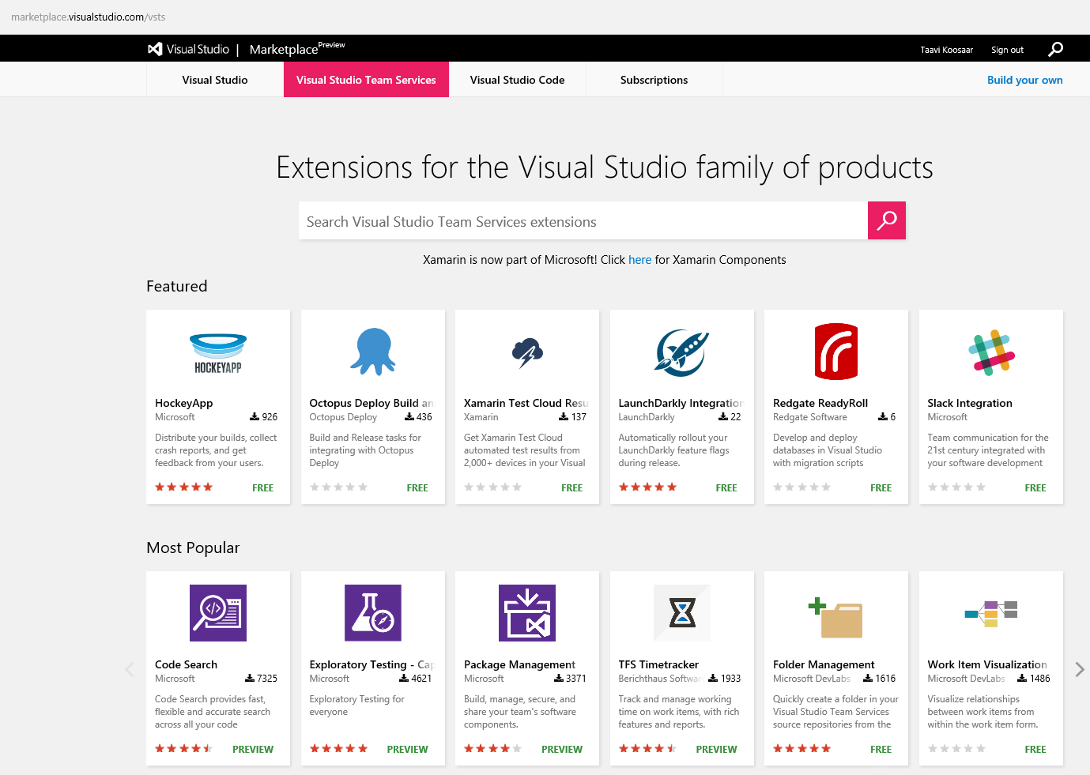
Visual Studio Marketplace

Slide 17
Demo: Release, Marketplace and few extensions

Slide 18
How to get started
Signup for VSTS for free (5 persons per account)
Signup to be a publisher on VS Marketplace
Use the Visual Studio Online Extensions Project Template
Have a look at sample Extensions on github
Extensions Overview
Read the official how to build your first extension guide
Read one of the many ”How i built my first VSO Extension” posts

Slide 19
Useful links
VSTS – www.visualstudio.com
VSTS Extensions
New Api - https://www.visualstudio.com/en-us/integrate/extensions/overview
(Old Api - https://www.visualstudio.com/en-us/integrate/api/overview)

Slide 20
Thank You!
Tkoosaar@windowslive.com | @melborp | github.com/melborp | linkedin.com/in/taavik

